Slide 1
Web Development 1
CSS Box Model & Text Shadow

Slide 2
CSS Box Model
The CSS box model can be used to control the spacing between headings, paragraphs and any block element on a page.
We will look at the following properties for a block element in the box model:
Height
Width
Margin
Padding
Border
background color
background image.

Slide 3
CSS Box Model
The formula for calculating the height of a box
top margin + top border + top padding + height +bottom padding + bottom border + bottom margin
The formula for calculating the width of a box
left margin + left border + left padding + width + right padding + right border + right margin

Slide 4
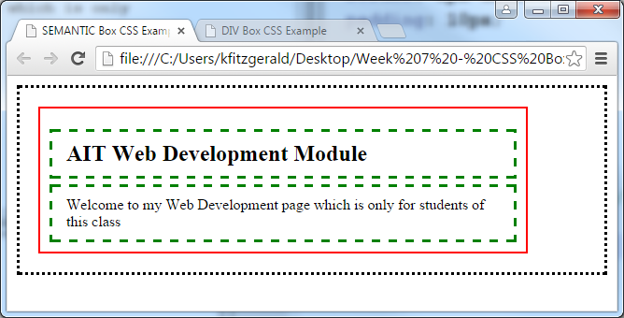
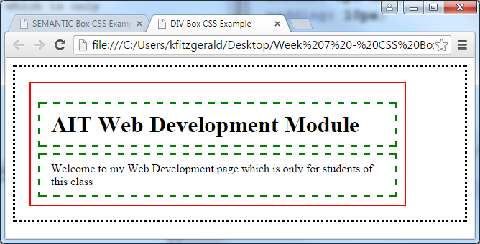
HTML5
XHMTML

Slide 5
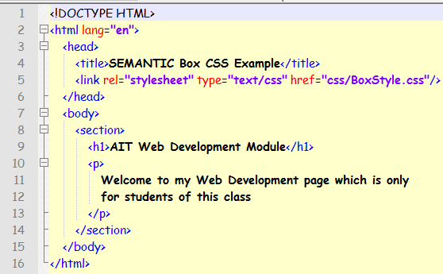
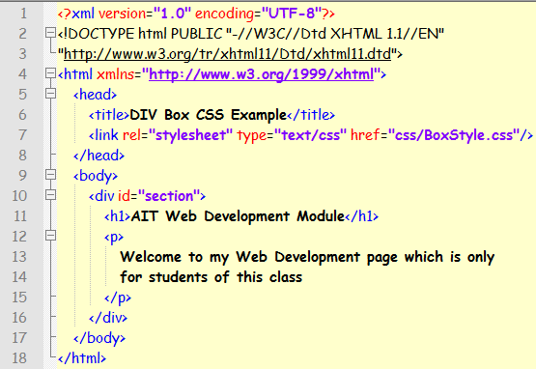
HTML5
XHMTML

Slide 6
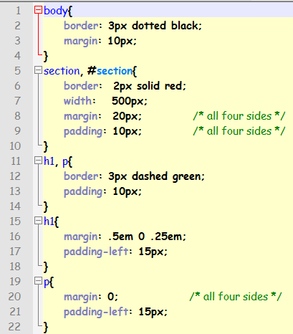

Slide 7
Collapsing Margins
The concept of collapsing margins means that adjoining margins of two or more boxes (which may be next to one another or nested) combine to form a single margin.
Properties for setting heights and widths
width
height
min-width
max-width
min-height
max-height

Slide 8
Margins
How to set the width of the content area
width: 450px; /* an absolute width */
width: 75%; /* a relative width */
width: auto; /* width based on content */
How to set the height of the content area
height: 125px;
height: 50%;
height: auto;
How to set the minimums and maximums
min-width: 450px;
max-width: 600px;
min-height: 120px;
max-height: 160px;

Slide 9
Margins
Properties for setting padding
padding-top
padding-right
padding-bottom
padding-left
Padding
How to set the padding on a single side
padding-top: 0;
padding-right: 1em;
padding-bottom: .5em;
padding-left: 1em;
How to set the padding on multiple sides
padding: 1em; /* all four sides */
padding: 0 1em;
padding: 0 1em .5em;
padding: 0 1em .5em 1em;

Slide 10
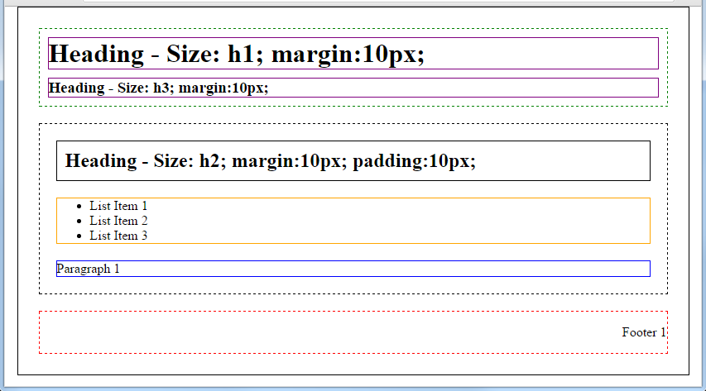
Example
Outside Solid Line shows <div id=“page”> outline
Dotted Lines show the inside <div> definitions
Inside solid lines show element borders
Pay attention to margins and padding

Slide 11
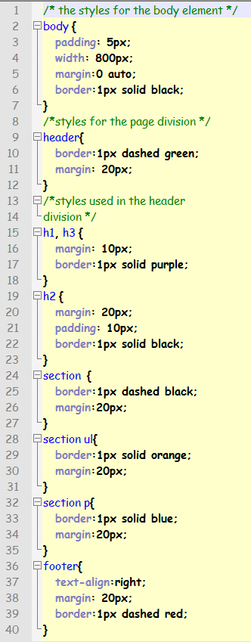
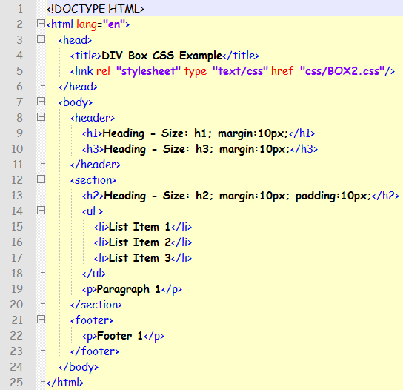

Slide 12

Exercise 1: HTML5 Page Setup
Download the Question.zip file from Moodle
Extract it into this weeks folder
Open the AIT_Web_Soc_H5.html page in NotePad++
Open the DEMO.css file in the CSS folder

Slide 13
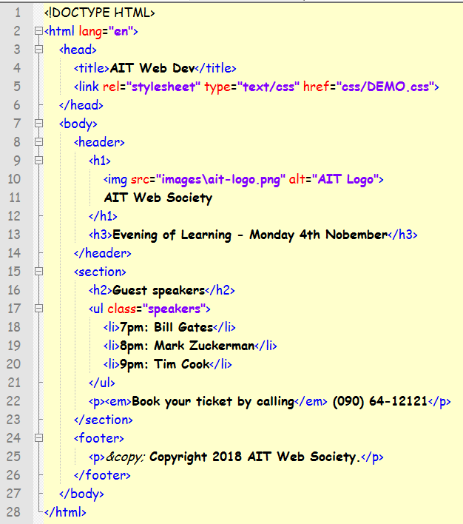

Slide 15

Exercise 1: Applying a style
Now create a style to generate the following – Don’t forget to link it to your page
Use the info on the following page to help you. If you get stuck, ask for help

Slide 16

Make some changes

Slide 17
How to set border properties
border: thin solid green;
border: 2px dashed #808080;
border: 1px inset; /* uses the element's color property */
How to set the widths of borders
border-width: 1px; /* all four sides */
border-width: 1px 2px;
border-width: 1px 2px 2px;
border-width: 1px 2px 2px 3px;
How to set the style of borders
border-style: dashed; /* dashed line all sides */
border-style: solid; /* solid line all sides */
border-style: solid none;
How to set the color of borders
border-color: green; /* a named color */
border-color: #808080; /* a hexadecimal value */
border-color: black gray;
How to set individual borders
border-top: 2px solid black;
border-right-style: dashed;
border-bottom-width: 4px;
border-left-color: gray;

Slide 18
CSS3 – Text Shadow
text-shadow: h-shadow v-shadow blur color;
Eg text-shadow: 3px, 3px, 5px, blue;
Value | Description
h-shadow | Required. The position of the horizontal shadow. Negative values are allowed
v-shadow | Required. The position of the vertical shadow. Negative values are allowed
blur | Optional. The blur distance
color | Optional. The color of the shadow.

Slide 19
New CSS3 properties
The border-radius and box-shadow properties
border-radius: radius; /* applies to all four corners */
border-radius: topLeft topRight lowerRight lowerLeft;
box-shadow: horizontalOffset verticalOffset blurRadius spread color;
Guidelines for backward compatibility
To round corners and add shadows in older versions of Firefox, you can use the -moz-border-radius and -moz-box-shadow properties.
To add shadows in older versions of Safari and Chrome, you can use the -webkit-box-shadow property.

Slide 20
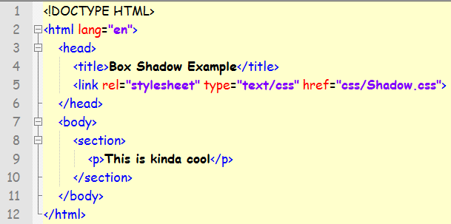
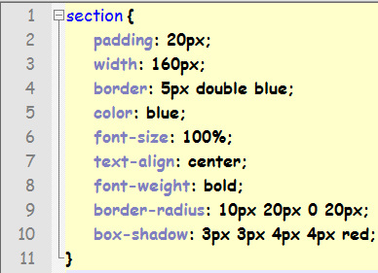
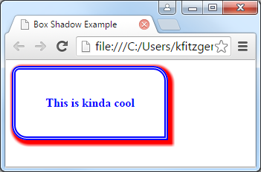

Slide 21
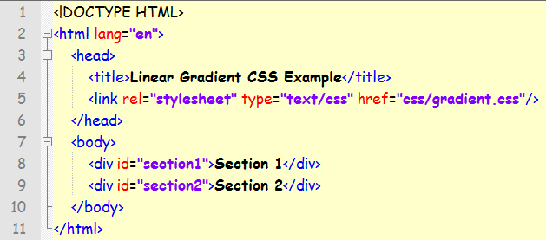
New CSS3 addition to background-image
div‘s can still be used in HTML5
The syntax for a linear gradient in the
background-image property
background-image:
linear-gradient(direction, color %, color %, ... );

Slide 22
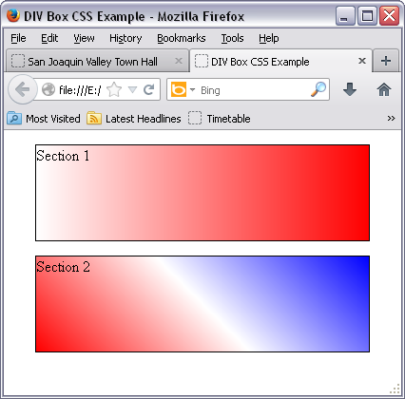
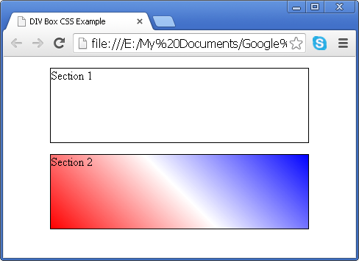
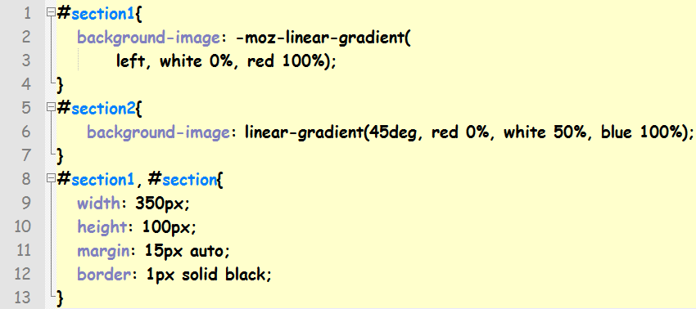
-moz- provides background compatibility for older versions of Firefox.

Slide 23
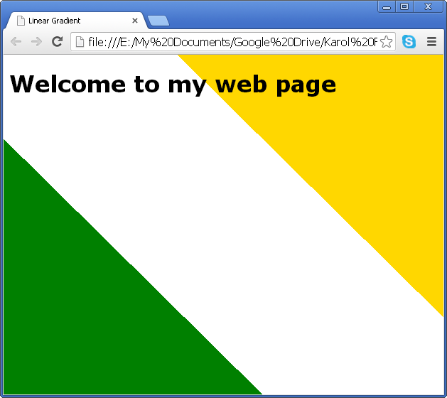

Slide 24
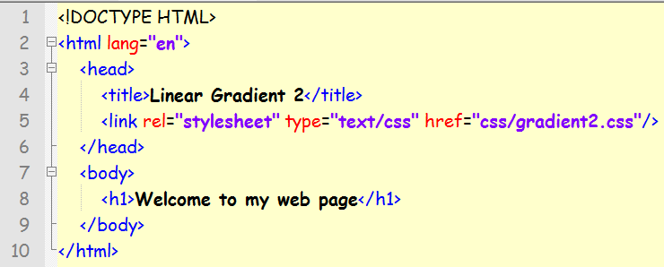
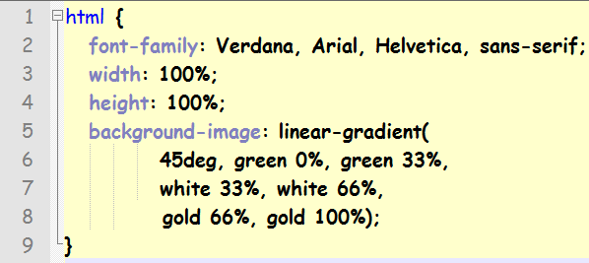

Slide 25
To Cover all browsers
The CSS for the web page
/* the styles for the html element (the background) */
html
{
background-image:
-moz-linear-gradient(top, white 0%, #facd8a 100%);
background-image:
-webkit-linear-gradient(top, white 0%, #facd8a 100%);
background-image:
-o-linear-gradient(top, white 0%, #facd8a 100%);
background-image:
linear-gradient(top, white 0%, #facd8a 100%);
}

